Slide 1
Module 1
Developing a Risk Mindset
Steve Morgan
Practice Based Evidence

Slide 2


<<<<< FROM
Fear, Blame & Risk Aversion
TO >>>>>
Working with Uncertainty & Positive Risk-Taking
“Curiosity is stronger than fear.” Katia Krafft

Slide 3

Are you a glass half full or glass half empty person?

Slide 4
On being more cautious…
Risk is generally defined in negative terms
We become risk averse to avoid negative outcomes
There is always a place for caution… when it is a clearly reasoned position
But… not if it is simply based in fear of being blamed for ‘what might go wrong’
There is no risk-free option!

Slide 5
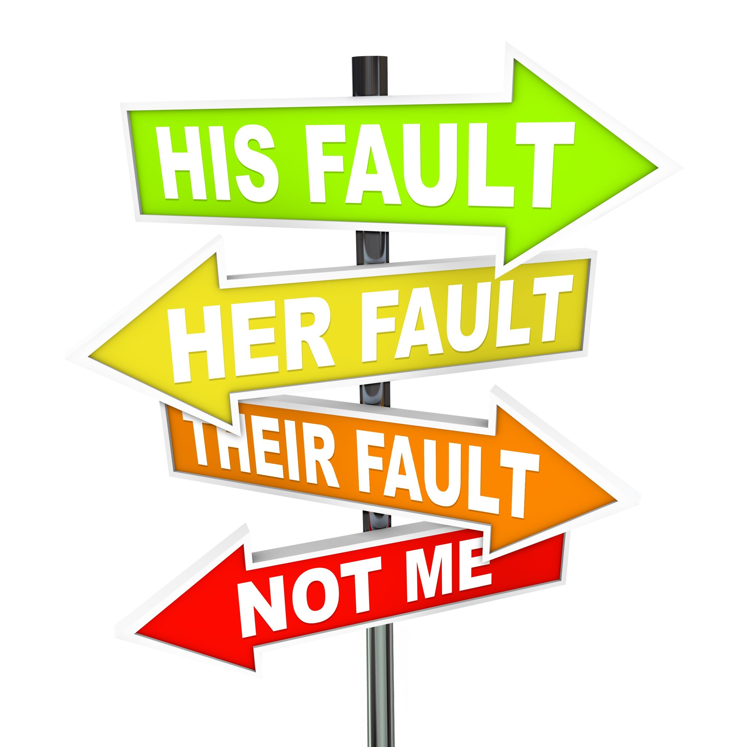

The Impact of Fear & Blame

Slide 6

“Life is inherently risky. There is only one big risk you should avoid at all costs, and that is the risk of doing nothing.” Denis Waitley

Slide 7

And the point is…?
We should be making clearly reasoned risk decisions
Focused on the benefits
Not just taking a chance… on a whim!

Slide 8
Based in clear principles…
Risk can never be entirely eliminated
Assessment is enhanced by accessing several sources of information
Identifying risk carries a duty to respond
Good teamworking is essential
Defensible not defensive decisions
Confidentiality is a right, but can be breached
Organisations should actively work to minimize the blame culture

Slide 9
What is Positive Risk-Taking?
The activity is taking risks
The reason we do it is for positive outcomes
If the person or practitioners are not clear about the positive outcome to be achieved the general rule is don’t take the risk
It is not a phrase to imply positive risk… this is too general and meaningless
Positive risk-taking is ‘very specific’ to an individual

Slide 10
Defining what we mean
Positive risk-taking is the weighing up of the potential benefits and harms of exercising one choice of action over another…
It is based in a clear appreciation of the risks (i.e. good risk assessment)…
It is the development of detailed plans and actions (i.e. good risk management)…
Based in the capabilities and expressed wishes of the individual person (i.e. a strengths approach)…
It is about achieving desired positive outcomes and minimizing the potential harmful outcomes. [Morgan, 2013]

