Slide 1
Module 2
Working with Risk
Steve Morgan
Practice Based Evidence

Slide 2
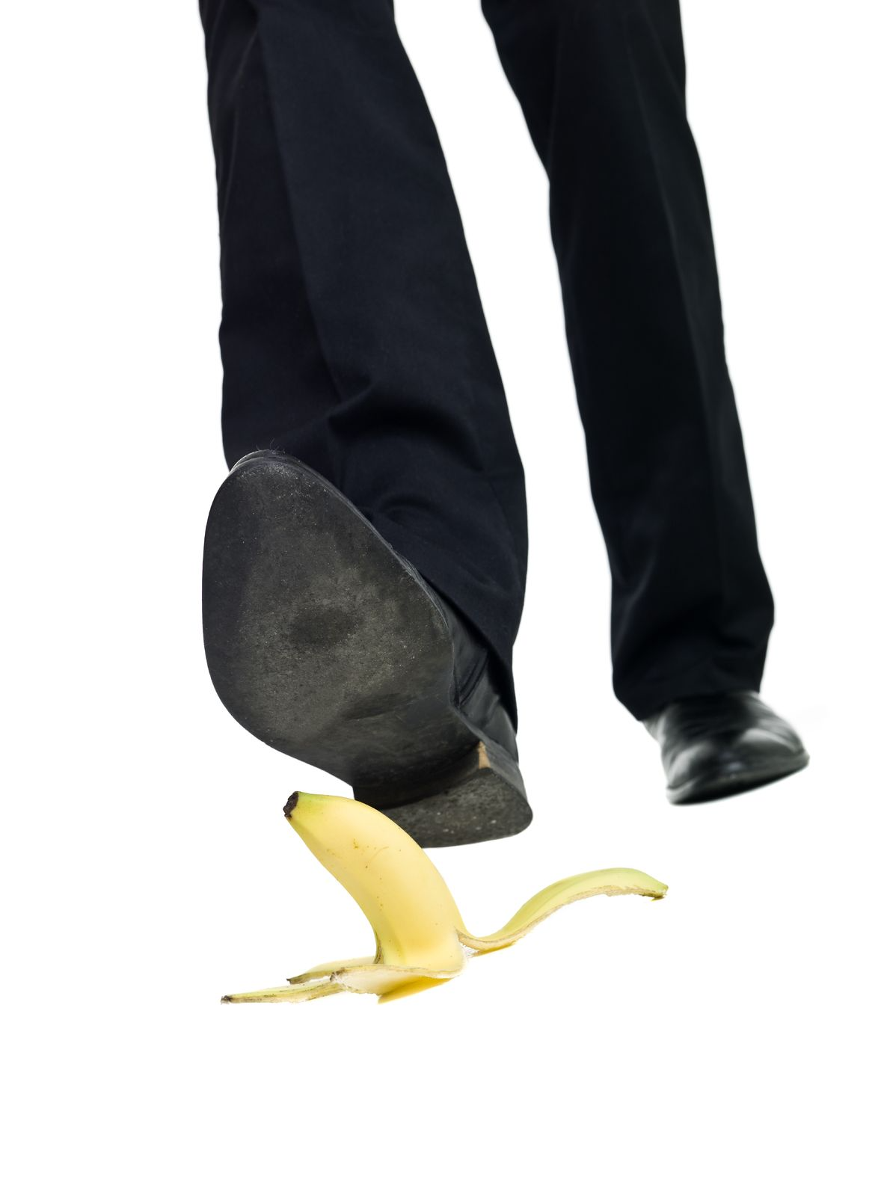
What risks?
In Health & Social Care the list goes on…
Suicide risk… self-harm… neglect… aggression and violence
Relationships
Communication difficulties
Housing tenure
Financial security
Jobs and vocational pursuits

Slide 3

Uncertainty
Working with risk is about relating to uncertainty
Decisions
Compromises
Sophisticated risk management doesn’t mean we have conquered risk
I guess I should have done a risk assessment first!

Slide 4

A Key Component…

Slide 5
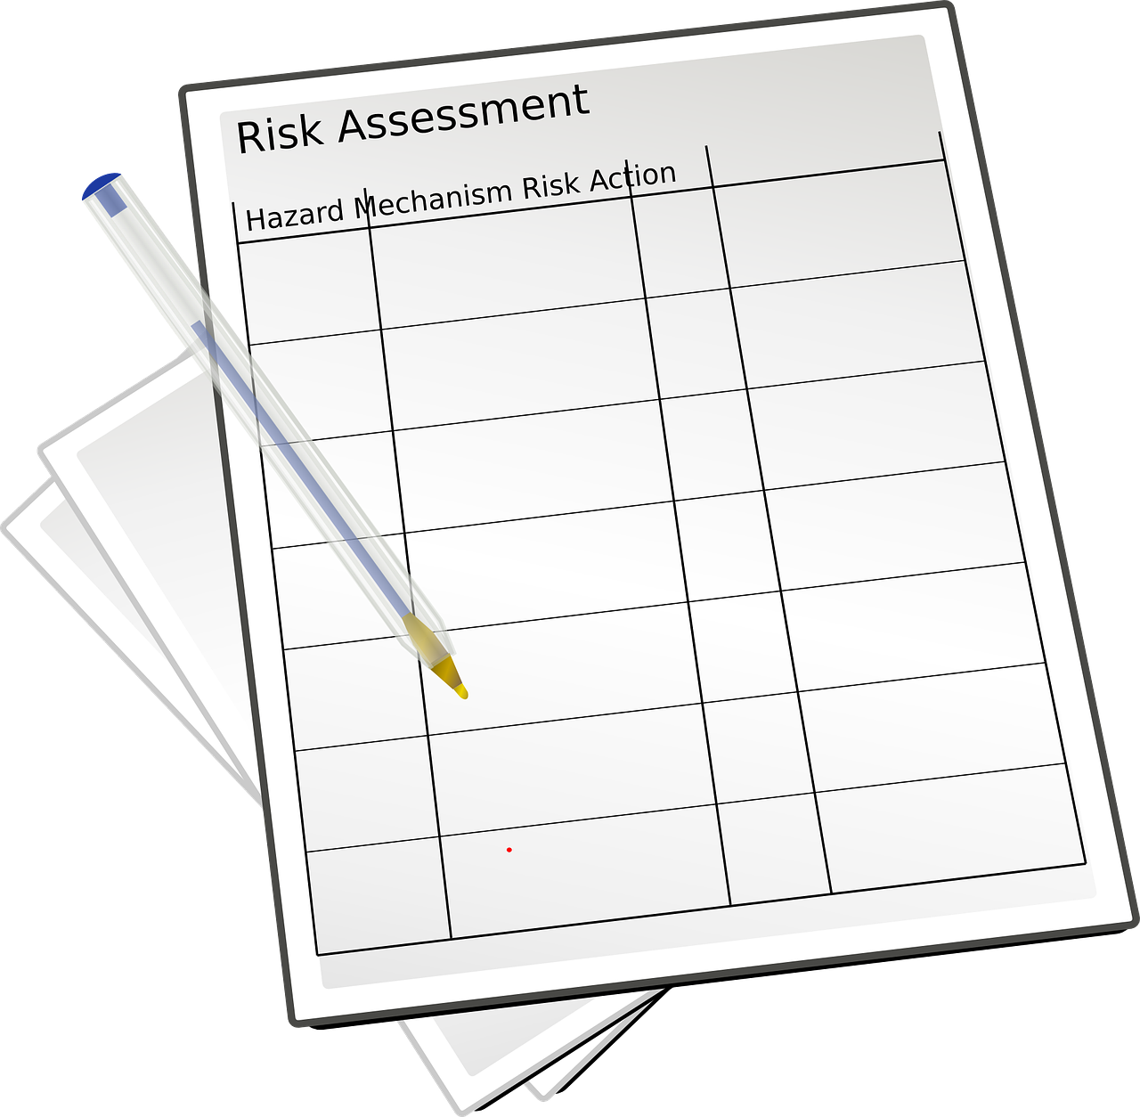
What is risk assessment?
It’s more about what we do before filling out paperwork!
A framework for guiding and prompting good practice
An element of linking past to present to potential future

Slide 6
Providing a definition
“Risk assessment is… the gathering of information through processes of communication, investigation, observation and persistence, and the analysis of potential outcomes of identified behaviours. Identifying specific risk factors of relevance to an individual, and the circumstances in which they may occur. It is also about counterbalancing the negativity of risk factors with the presence of protective factors, that is, the qualities or resources in and around a person that help to reduce or mitigate potential risk. This process requires linking historical information to current circumstances in order to anticipate possible future change. Risk assessment should be distinguished separately from risk screening, which is an initial process of determining which risks require more detailed and thorough processes of assessment.”
[Morgan 2013]

Slide 7

Avoid the prediction trap!

Slide 8
A Structured Approach
Flexibility & creativity
Evidence base is very narrow
Tools need to be fit for purpose
- bureaucracy v narrative format
- real life and documented forms
- acting as an aide memoir
Screening tool v Risk assessment

Slide 9
What is Risk Formulation?
An adaptation of the psychological concept of formulation
Constantly asking the why questions… continually being inquisitive
Testing out your thoughts and ideas… remaining open to change
Making judgements of the likelihood of risk within its specific context

