Slide 1
Module 3
Working with People
Steve Morgan
Practice Based Evidence

Slide 2

Influence of our Values
Everything we think, decide and do…
Decision-making
Lone working
Teamworking

Slide 3
Establishing a principle
DH (2007): “Risk management should be conducted in a spirit of collaboration and based on a relationship between the service user and their carers that is as trusting as possible.”
Discussing risk history & potential should ideally be happening as early as possible

Slide 4
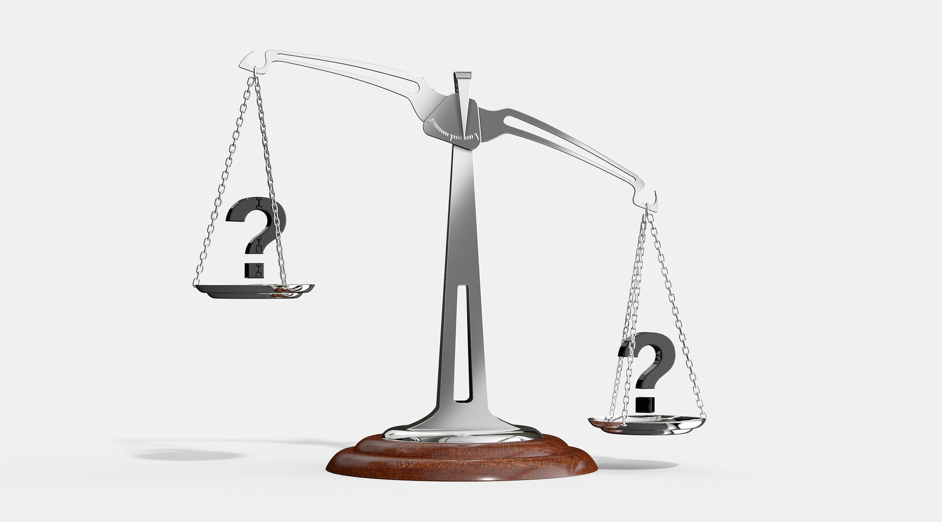
A philosophical conflict
Balancing sometimes conflicting needs:
Supporting the individual
Individual liberties
V.
Protecting others
Public safety

Slide 5
An empowering process
Information is power, so share it
Understanding personal experiences and perceptions of others
Collaborative discussions
Jointly identify early warning signs
Negotiation and person-centred working
Importance of choice with flexible support

Slide 6
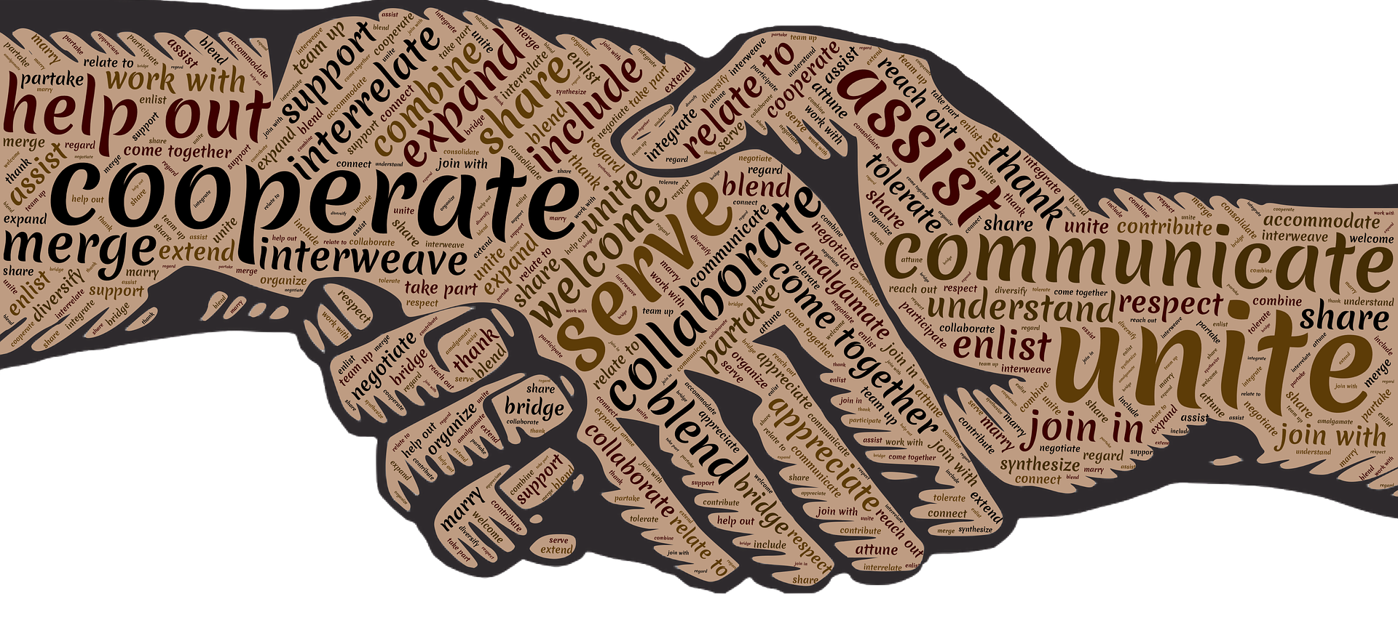
We all need a helping hand occasionally…
if we are to achieve our goals

Slide 7
Engagement is…
The process whereby a practitioner approaches a person… as the first stage in establishing a trusting working relationship… attempting to build something positive, as the foundation for a constructive partnership.
The success of all subsequent assessment, planning and action will be determined by it!

Slide 8
Keys to engagement
Are you a travel agent, or a travel companion?
You don’t get a second chance to create first impressions!
Issues of difference… or similarities… use as leverage for conversation
There is no simple formula… each will be a unique event.

Slide 9
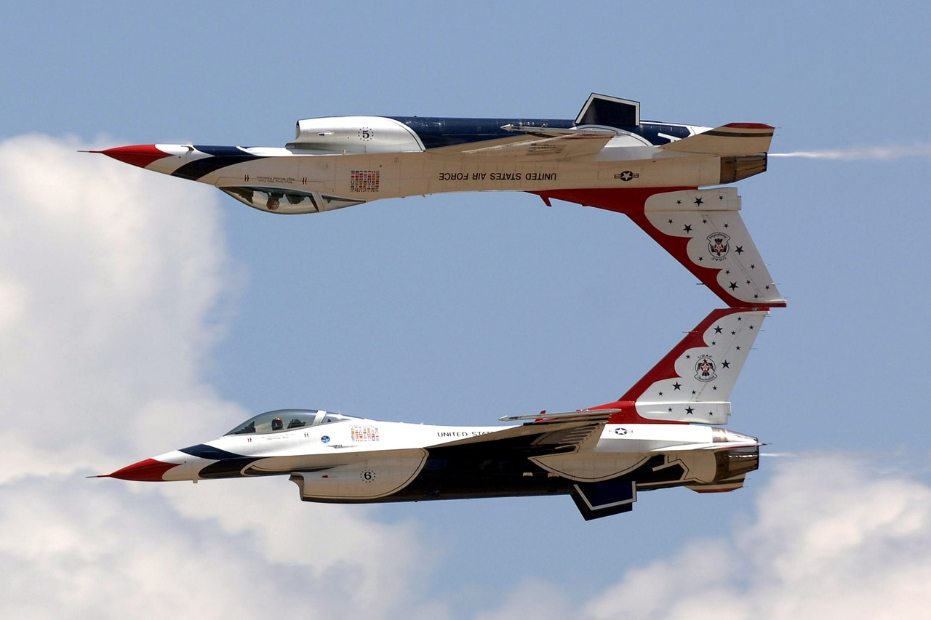
Teamwork

Slide 10
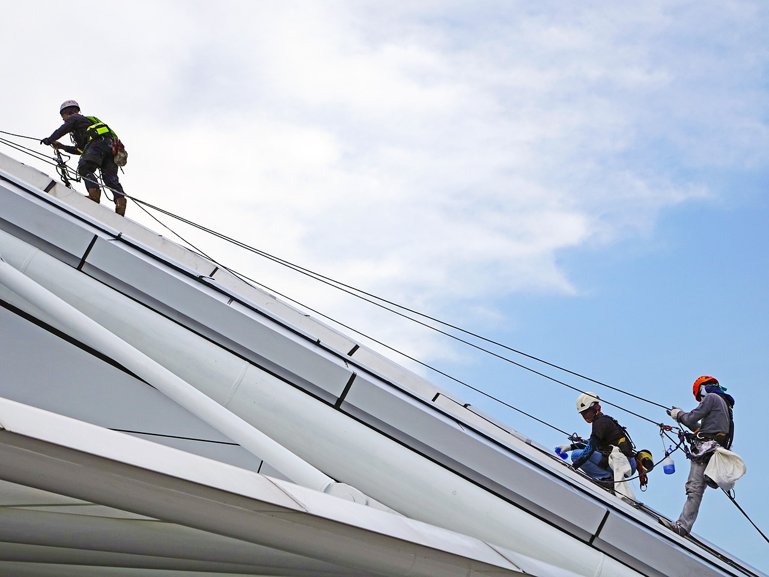
Teamwork requires effort
“With an enthusiastic team you can achieve almost anything.”
Tahir Shah

Slide 11

Meetings… anyone?
Fundamental to teamworking
“Meetings are indispensable, when you don't want to do anything!” J.K. Galbraith
Chairing… agenda’s… time management

Slide 12
But, when it comes to taking the risk
We are faced with challenging decisions
We are still fearful of blame
Collaboration will usually achieve more confident decisions
A shared decision leads to more confident action
A cohesive group is more difficult to undermine than an individual acting alone

Slide 13
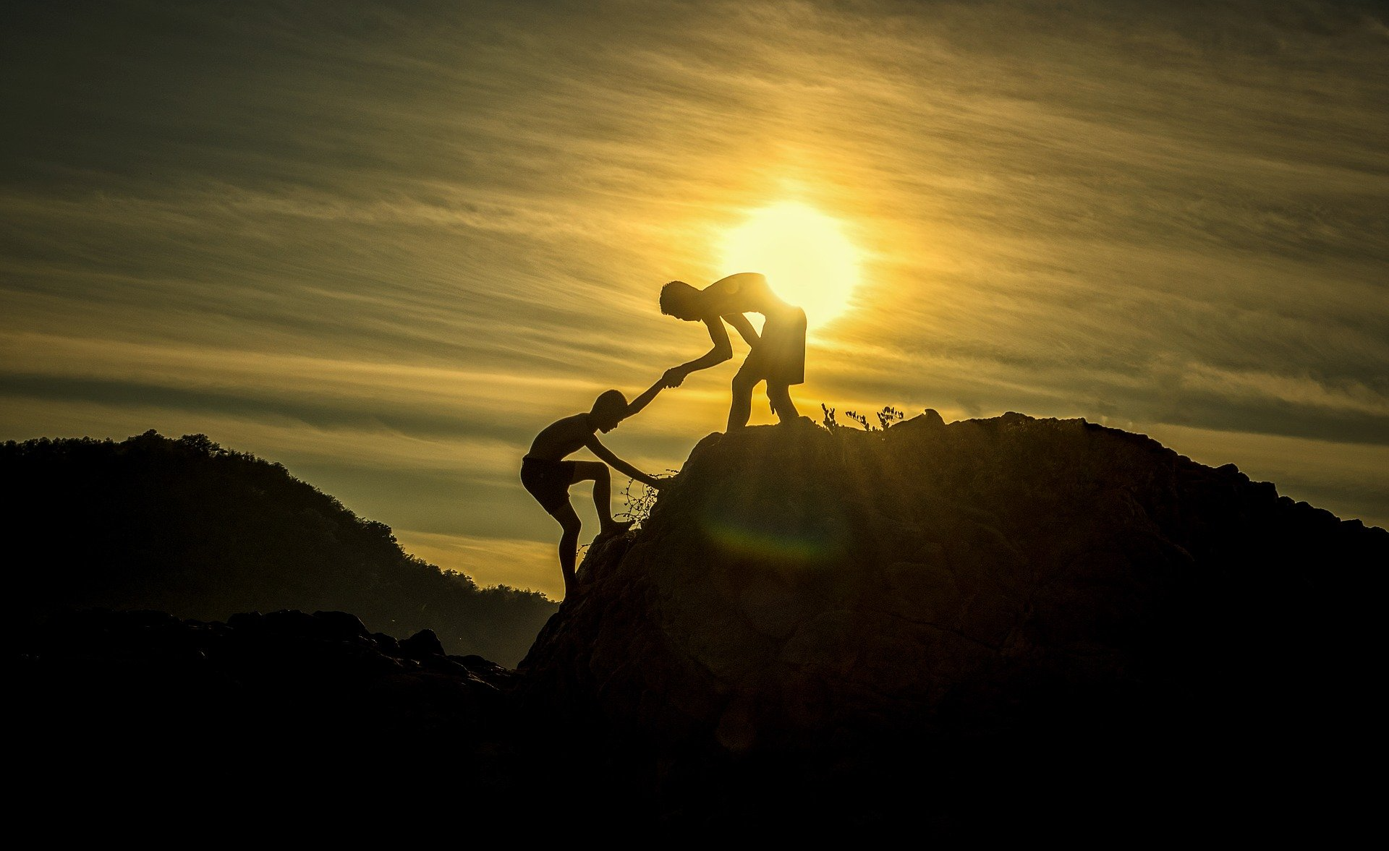
Working with people

