Slide 1
Module 4
Working with Strengths
Steve Morgan
Practice Based Evidence

Slide 2
A Strengths Quote
“If human beings are perceived as potentials rather than problems, as possessing strengths instead of weaknesses, as unlimited rather than unresponsive, then they thrive and grow to their capabilities.”
(Barbara Bush)
Steve Morgan ~ Practice Based Evidence

Slide 3
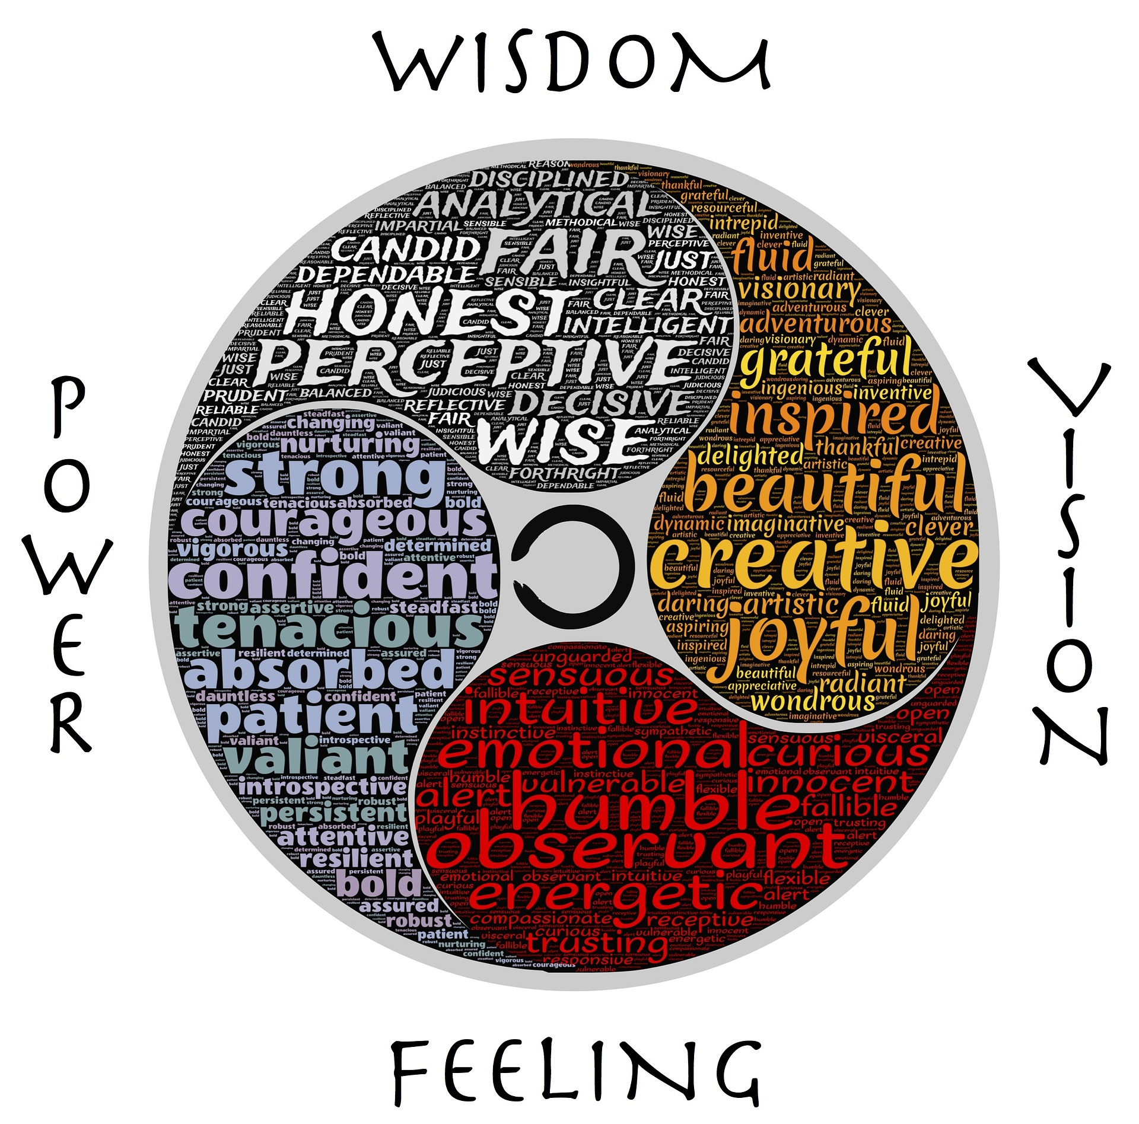
Language of strengths
Developing a shift…
From:
Diagnosis, disability, difficulties and problems
To:
Positive qualities, abilities, and potential
Steve Morgan ~ Practice Based Evidence

Slide 4
What is a Strengths Approach?
A challenge to the inherently negative focus of attention adopted by the traditional problems-oriented approach
Recognition that everyone has talents, abilities, interests, achievements, capabilities, wants, dreams and wishes
A person-centred way of thinking and working focused on inspiring hope
Steve Morgan ~ Practice Based Evidence

Slide 5
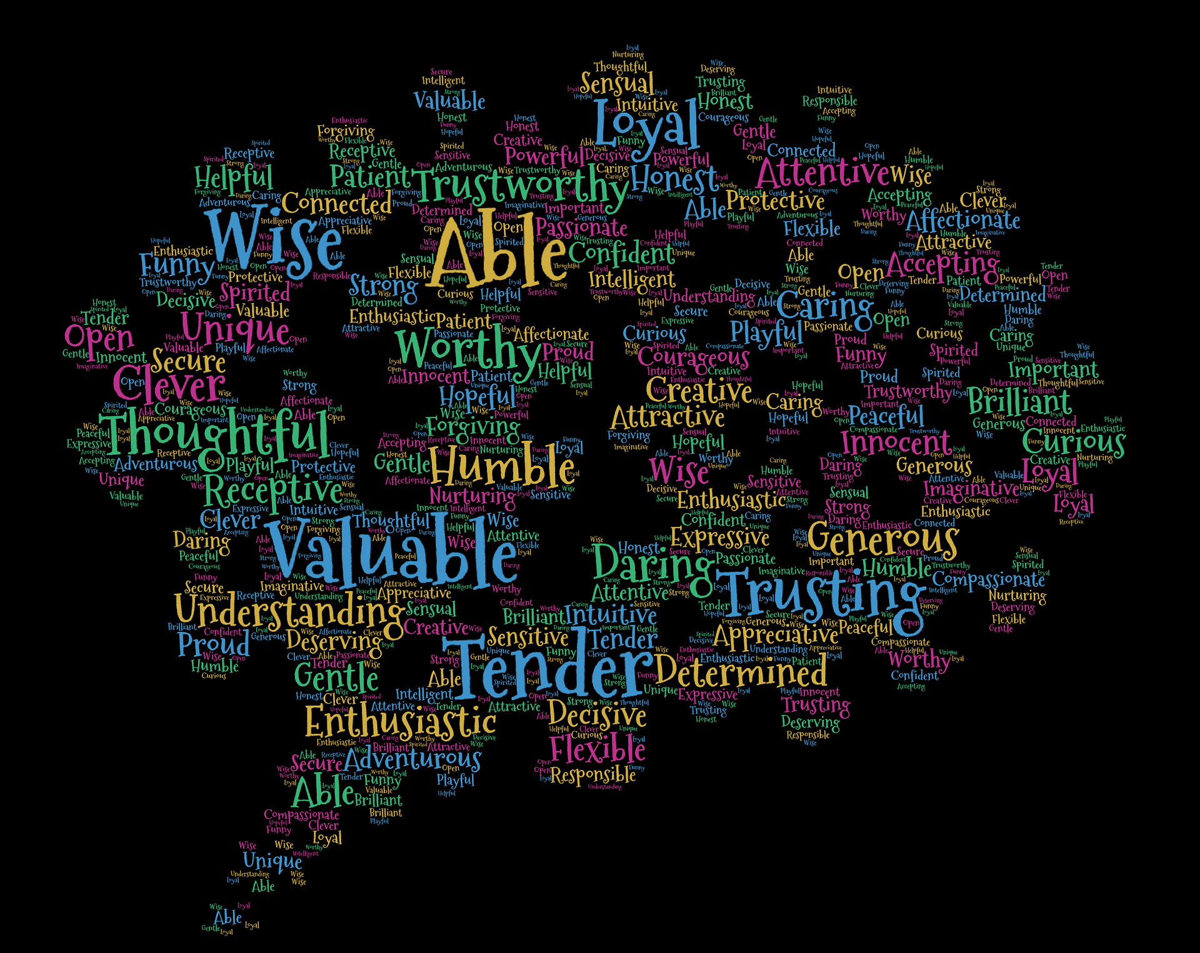
Positive personal qualities
Steve Morgan ~ Practice Based Evidence

Slide 6
What is a Strengths Approach?
A process for continual listening and learning
Focusing on what is important to someone now and in the future
Acting upon this in alliance with their family and friends
Supporting people to develop their own real personal resources and resourcefulness
- Resources open up opportunities
- Opportunities inspire confidence
- Confidence breeds successes & achievements
Steve Morgan ~ Practice Based Evidence

Slide 7

Resources & Opportunity
Steve Morgan ~ Practice Based Evidence

Slide 8
How is a Strengths Approach applied in practice?
Asking ‘how do you cope’ and ‘what do you want’ is a start… but is not enough
It is more about:
A personal attitude towards your work
Applying values & principles for real
Thinking ‘strengths’ as a default position
Where does this fit with appreciating people’s problems?
Steve Morgan ~ Practice Based Evidence

Slide 9

Steve Morgan ~ Practice Based Evidence

Slide 10
How is a Strengths Approach applied in practice?
It is primarily about what you do in your interactions with people
Identifying strengths happens from the point of first contact
Paperwork is there to guide and reflect what is happening in practice
Reality is dynamic so the working documents require continuous updating as needed
Steve Morgan ~ Practice Based Evidence

Slide 11
Strengths Quote
“If you spend your life trying to be good at everything, you will never be great at anything.”
Tom Rath, Gallup Research
Steve Morgan~ Practice Based Evidence

Slide 12
Accessing appropriate tools
Service user strengths-based practice
Individual staff members strengths assessments
Team strengths assessments
Strengths of the systems & the organisation itself
Steve Morgan ~ Practice Based Evidence

