Slide 1
Module 5
Risk Decision-Making
Steve Morgan
Practice Based Evidence

Slide 2

The blame game
If we fear the consequences of our decisions going wrong we are more likely to be cautious or risk averse… attributing more weight to the potential for a risk decision to go wrong
We become more indecisive
Our decisions need a positive strengths-based counterbalance
Steve Morgan ~ Practice Based Evidence

Slide 3
Decision-Making Quotes
“Good decisions come from experience, and experience comes from bad decisions.” Mark Twain
“Informed decision-making comes from a long tradition of guessing and then blaming others for inadequate results.” Scott Adams
“Some people are very decisive, when it comes to avoiding decisions.” Brendan Francis
Steve Morgan ~ Practice Based Evidence

Slide 4
Intuition
“Knowing without knowing how you know.”
“True experts know the limits of their knowledge; many pseudo-experts have no idea that they do not know what they are doing.”
Kahneman (2011)
Steve Morgan ~ Practice Based Evidence

Slide 5
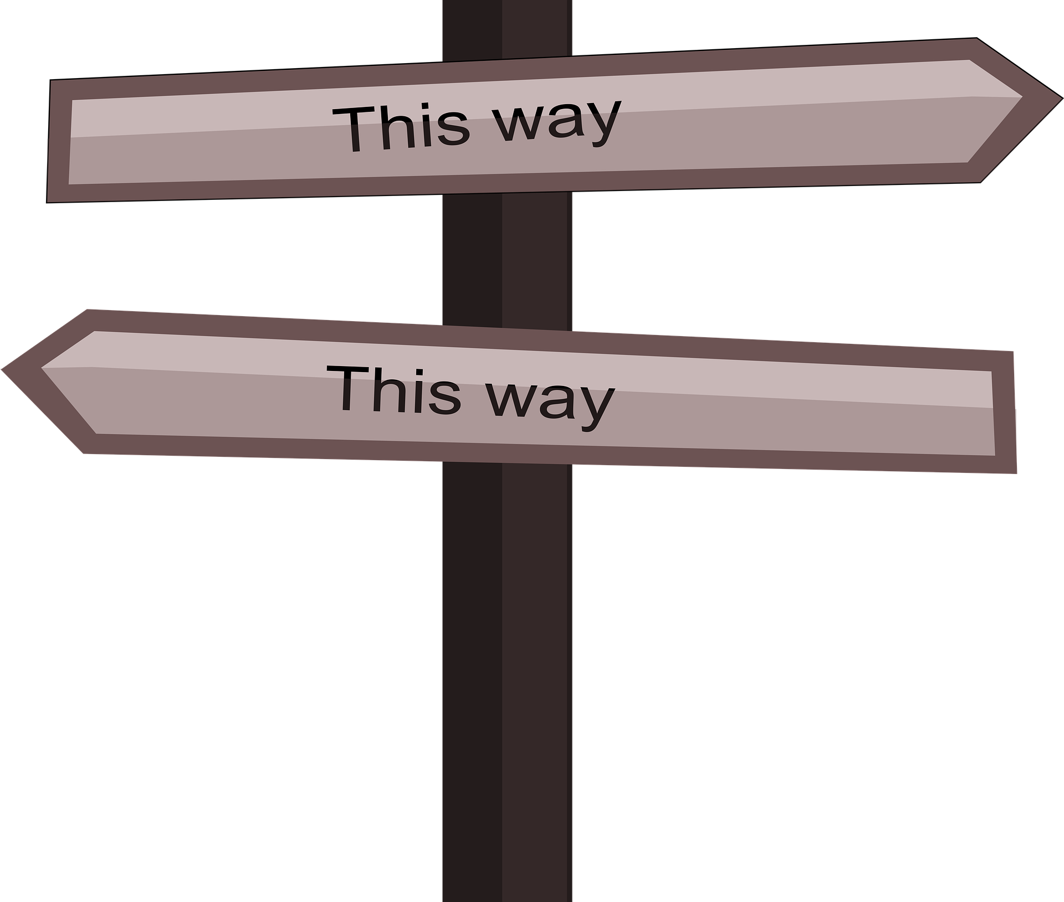
System 1
Operates automatically and quickly
Little effort or control
Covers most of our simpler daily decisions
Intuitive responses to processed information
The focus is on feeling
Steve Morgan ~ Practice Based Evidence

Slide 6
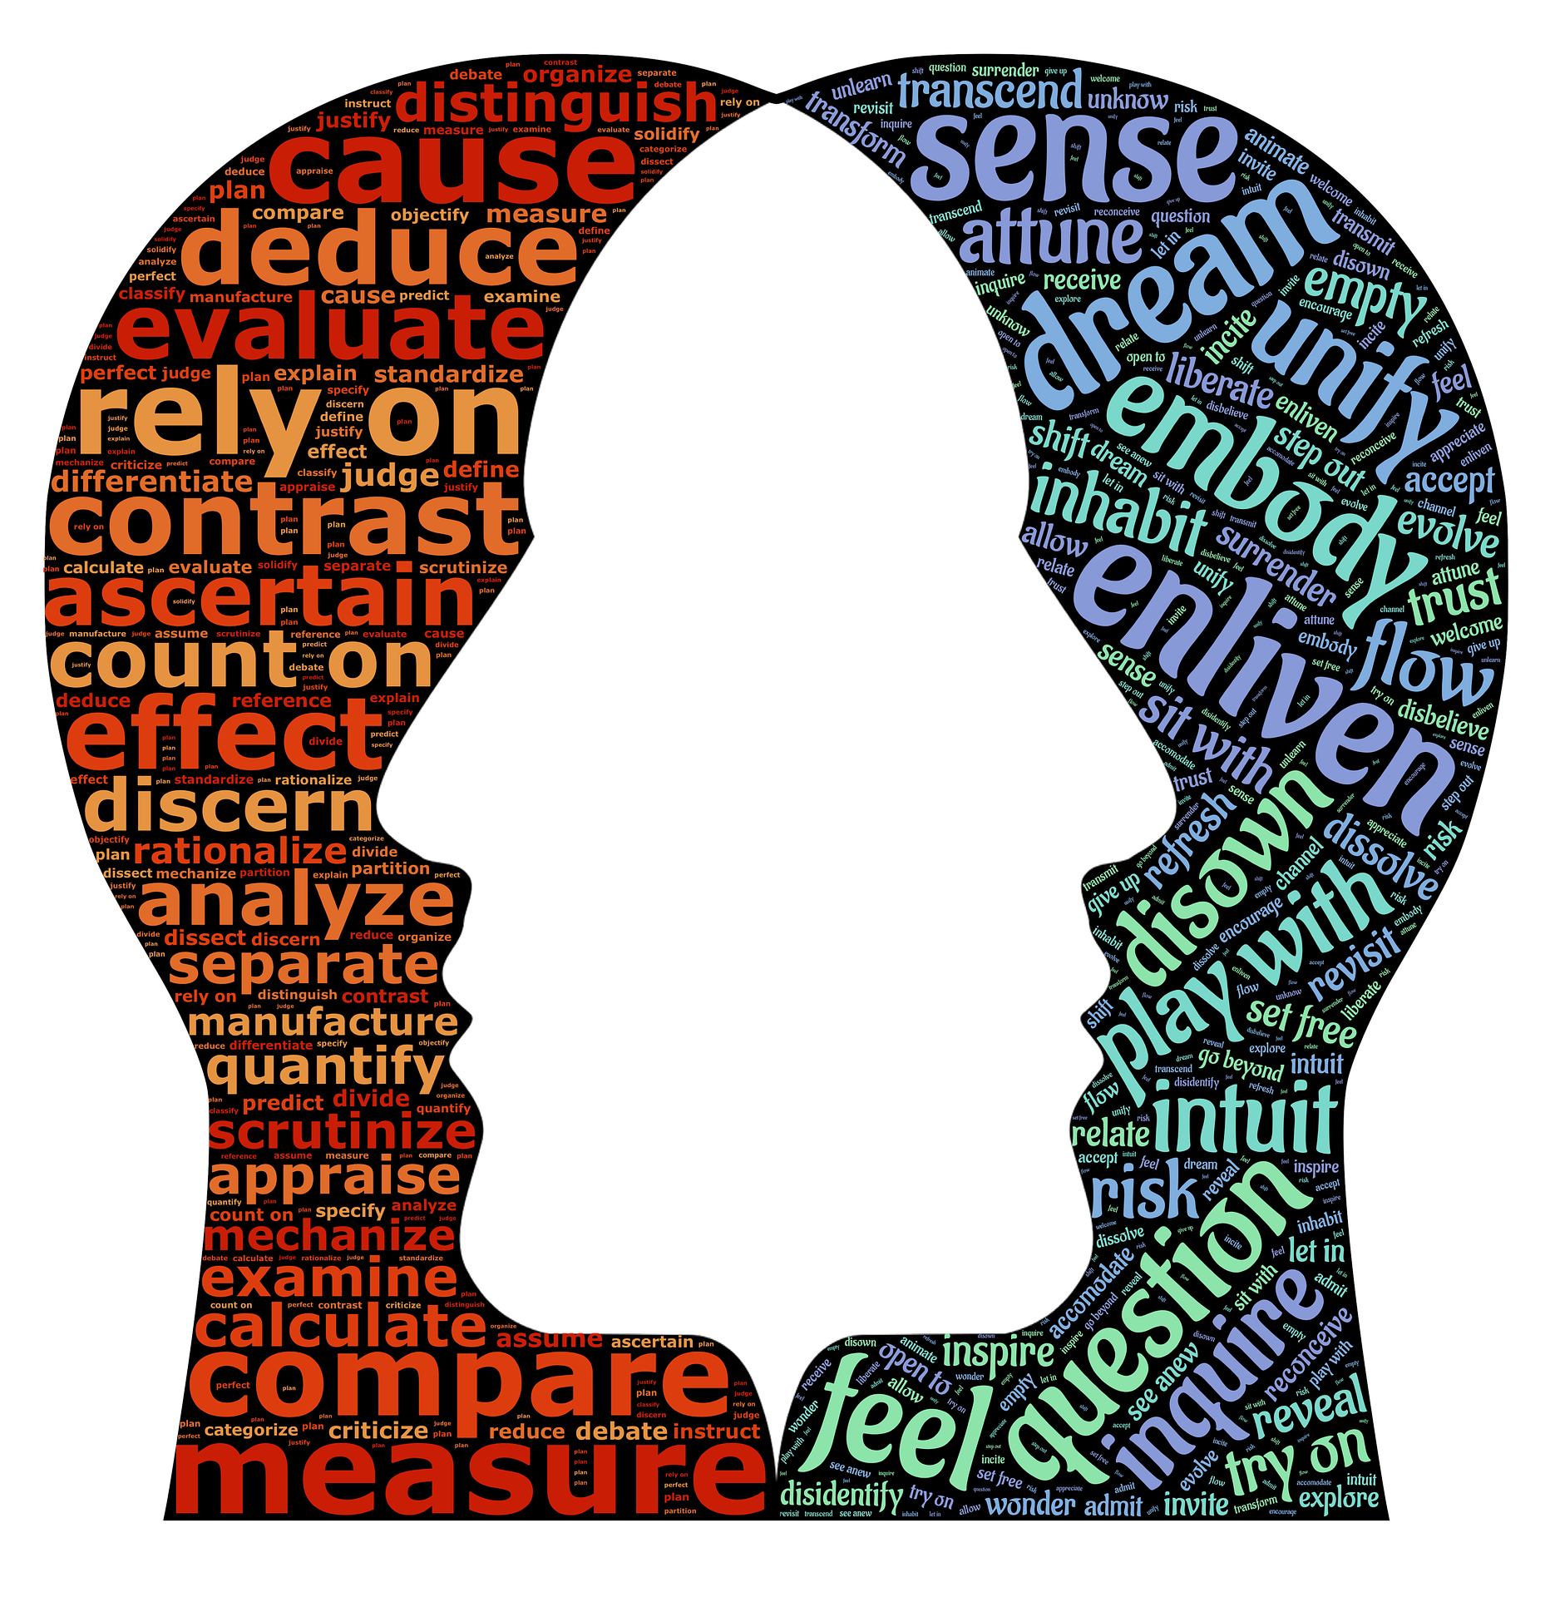
System 2
Attention to effortful mental activity
Complex computations
Our more challenging decisions
Deeper analytical thinking
The focus is on reason
Steve Morgan ~ Practice Based Evidence

Slide 7

Steve Morgan ~ Practice Based Evidence

Slide 8
A Structured Approach
A bridge between the process of information gathering assessment and putting a plan into action
Risk formulation
Risk Decision-Making Checklist
Steve Morgan ~ Practice Based Evidence

Slide 9

“If you don’t risk anything, you may risk everything”
[Anon]
Steve Morgan ~ Practice Based Evidence
Notes:
Philosophically, positive risk-taking is important in the field of mental health (and beyond) because, to deprive people of the right to exercise personal choice and supported decision-making has consequences.
Firstly, it narrows the range of vision to what professionals decide is best for the person, which can easily be driven by their own need for self-preservation within a real or perceived blame culture.
Secondly, it may communicate to people that the approach taken by services is not really that relevant to their own experience, so giving them reasons to disengage from those very services… an act in itself that could possibly raise the risk stakes for the individual.
Sometimes, we simply don’t know what we could experience and gain until we try. “If you don’t risk anything, you may risk everything.” (Anon).

Slide 10
Questions for organisational management
How much emphasis is placed on reputational risk?
How is individual v collective decision-making managed?
Is a risk decision-making hierarchy operating at different staffing levels?
Do you promote the use of a structured approach to risk decision-making?
How are decisions predominantly documented?
Steve Morgan ~ Practice Based Evidence

Slide 11
In conclusion
Consistency of practice should emerge out of a clear risk policy
Routine procedures need routine protocols
Documenting risk is not about completing excessive forms… it is about accessible reasoned decision-making
A role for supervision and collective decision-making
Steve Morgan ~ Practice Based Evidence

Slide 12


Head v Heart & Light Bulb Moments
Steve Morgan ~ Practice Based Evidence

